Slide 1
Superstore Data Analysis
Dhiraj Mahato

Slide 2
Problem Statement
Superstores are experiencing stagnant growth in both sales and profits, which is hindering other stores overall business performance. Despite various efforts to enhance the revenue of this Superstore, the desired increase in sales and profitability has not been achieved. This analysis aims to identify key factors affecting sales and profits, uncover trends and patterns within the data, and provide actionable insights and recommendations to drive growth and improve the financial health of the Superstore.

Slide 3
Project Description
This project involves the analysis of the Sample Superstore dataset sourced from Kaggle to identify key factors impacting sales and profitability. Using Python libraries such as Pandas for data manipulation and Matplotlib for data visualization, we will conduct an in-depth examination of the dataset. The goal is to uncover actionable insights and trends that the store manager can leverage to drive increased sales and enhanced profitability. Our analysis will focus on identifying underperforming segments, high-potential products, and effective strategies for optimizing the overall performance of the Superstore.

Slide 4

Who are the End Users ?
01
Store Owners/ Managers
Marketing Team
02
Sales Team
Financial Analysts
03
04
Business Consultants
Data Analysts & Scientists
05
06
Supply Chain & Inventory Managers
07

Slide 5
Tcechnologies used
Here are the technologies used in this project:
1. Python: The primary programming language used for data analysis.
2. Pandas: A Python library for data manipulation and analysis. It is used to clean, process, and explore the dataset.
3. Matplotlib: A Python plotting library used for creating static, animated, and interactive visualizations to represent the insights derived from the dataset.
4. Jupyter Notebook: An open-source web application that allows you to create and share documents that contain live code, equations, visualizations, and narrative text. It is used for documenting the analysis process and presenting the findings in an interactive manner.
5. Kaggle: A platform that provides datasets, including the Sample Superstore dataset used in this project.

Slide 6
Results
Code Link ( Github)
Dataset Link

Slide 7
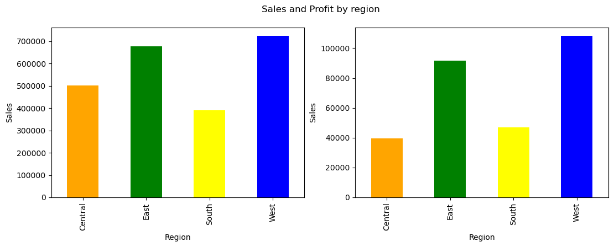
01
By analysing the bar plot we have analysed that
1. Sales and profit is maximum in West Region.
2. We have noticed though sales is high in Central compared to South the Profit of lowest for Central Region.

Slide 8
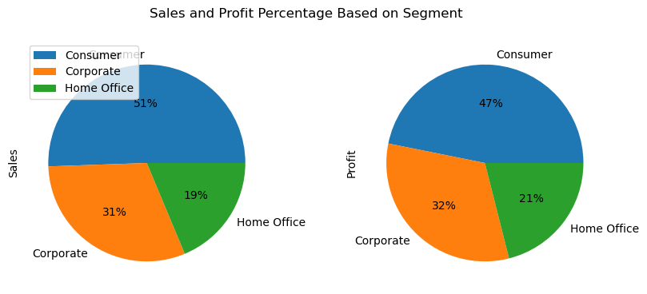
02
By analysing the pie chart we have analysed that
1. Sales and profit is maximum for the consumer segment goods.
2. And lowest profit and sales for Home Office segment goods.

Slide 9
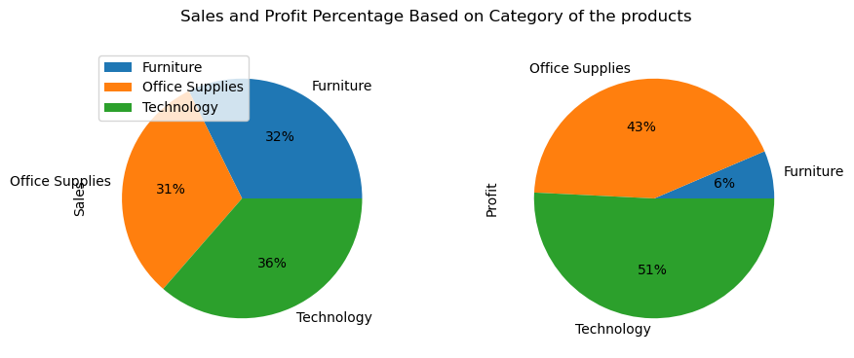
03
By analysing the pie chart we have analysed that
1. Sales is almost same for the product category.
2. But when comes to profits the product category for Technology generates 50% profit compared to others.
3. The product category for Furniture have the lowest profit among all.

Slide 10
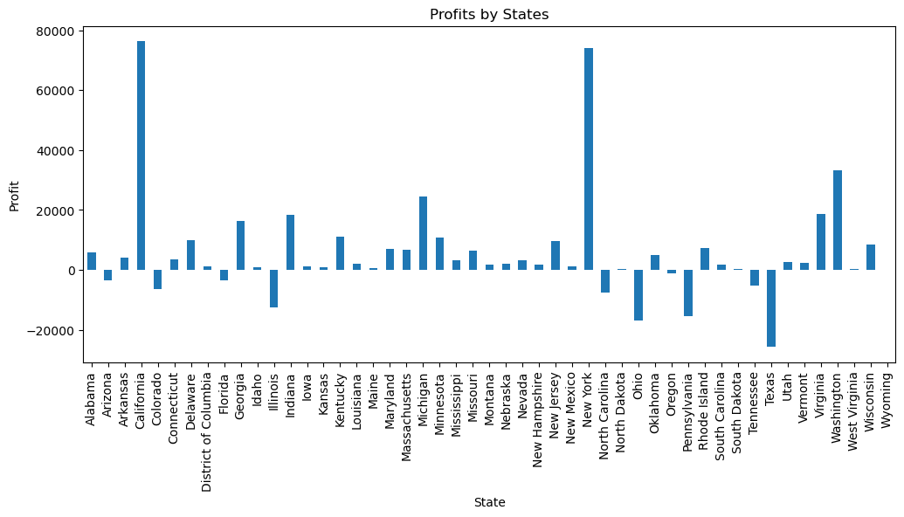
04
By analysing the bar plot we have analysed that
1. The states California and New York have the highest profits.
2. We have seen that there are some loss making states present.

Slide 11
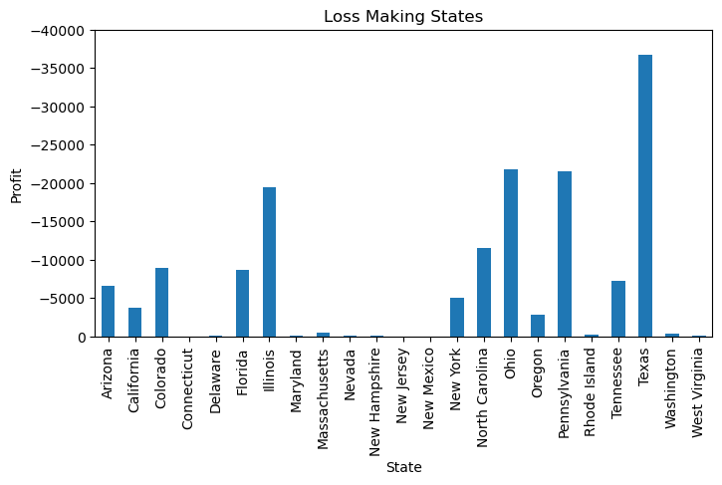
05
By analysing the bar plot we have analysed that
There are 23 states total which have negative profits.
2. The state Texas have maximum loss.

Slide 12

Thank You
LinkedIn
dhirajmahato832@gmail.com

